Slide 1
CSE / T / 423C Distributed Computing Topic 8: Container, Docker, Kubernetes, AWS Services
Sarbani Roy
Department of Computer Science & Engineering
Jadavpur University E-mail: sarbani.roy@jadavpuruniversity.in
Room: CC-5-7
Phone: 9051639328

Slide 2
Advantages of Virtualization
Minimize hardware costs
Multiple virtual servers on one physical machine
Easily move VMs to other physical machine
Consolidation
Increase device utilization
Conserve power
Simplified provisioning/administration of hardware and software
Scalability and Flexibility
Multiple operating systems

Slide 3
Problems of virtualization
Each VM requires an operating system (OS)
Each OS requires a license ⇒ CapEx
Each OS has its own compute and storage overhead
Needs maintenance, updates ⇒ OpEx
VM Cost= CapEx + OpEx

Slide 4
Solution
Run many apps in the same virtual machine
These apps share the OS and its overhead
But these apps can’t interfere with each other
Can’t access each other’s resources without explicit permission
Like apartments in a complex
⇒ Containers

Slide 5
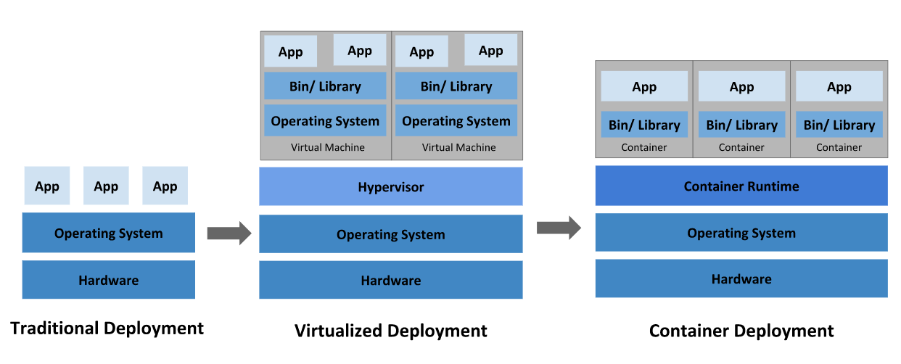
Traditional vs Virtualized vs Container

Slide 6
Containers
Multiple containers run on one operating system on a virtual/physical machine
All containers share the operating system Containers are isolated ⇒ cannot interfere with each other
Own file system/data, own networking ⇒ Portable

Slide 7
Containers
Containers have all the good properties of VMs
Come complete with all files and data that you need to run
Multiple copies can be run on the same machine or different machine ⇒ Scalable
Same image can run on a personal machine, in a data center or in a cloud
Operating system resources can be restricted or unrestricted as designed at container build time
Isolation: For example, “Show Process” (ps on Linux) command in a container will show only the processes in the container
Can be stopped. Saved and moved to another machine or for later run

Slide 8
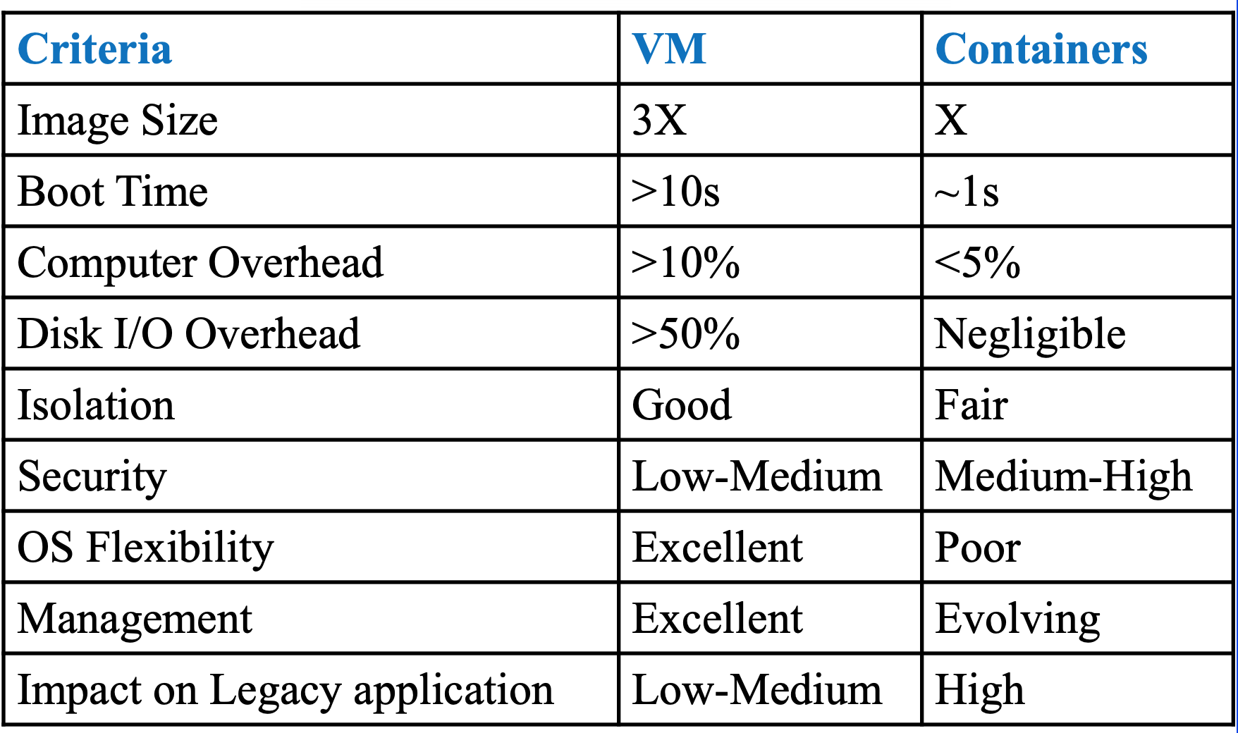
VM vs Containers
Ref: Weldon, M.K. (2016). The Future X Network: A Bell Labs Perspective (1st ed.). CRC Press. https://doi.org/10.1201/9781315365756

Slide 9
Docker
Docker is an open platform for developing, shipping, and running applications
Docker enables to separate applications from infrastructure
Docker provides the ability to package and run an application in a loosely isolated environment called a container
The isolation and security allow you to run many containers simultaneously on a given host
Containers are lightweight and contain everything needed to run the application, so you do not need to rely on what is currently installed on the host

Slide 10
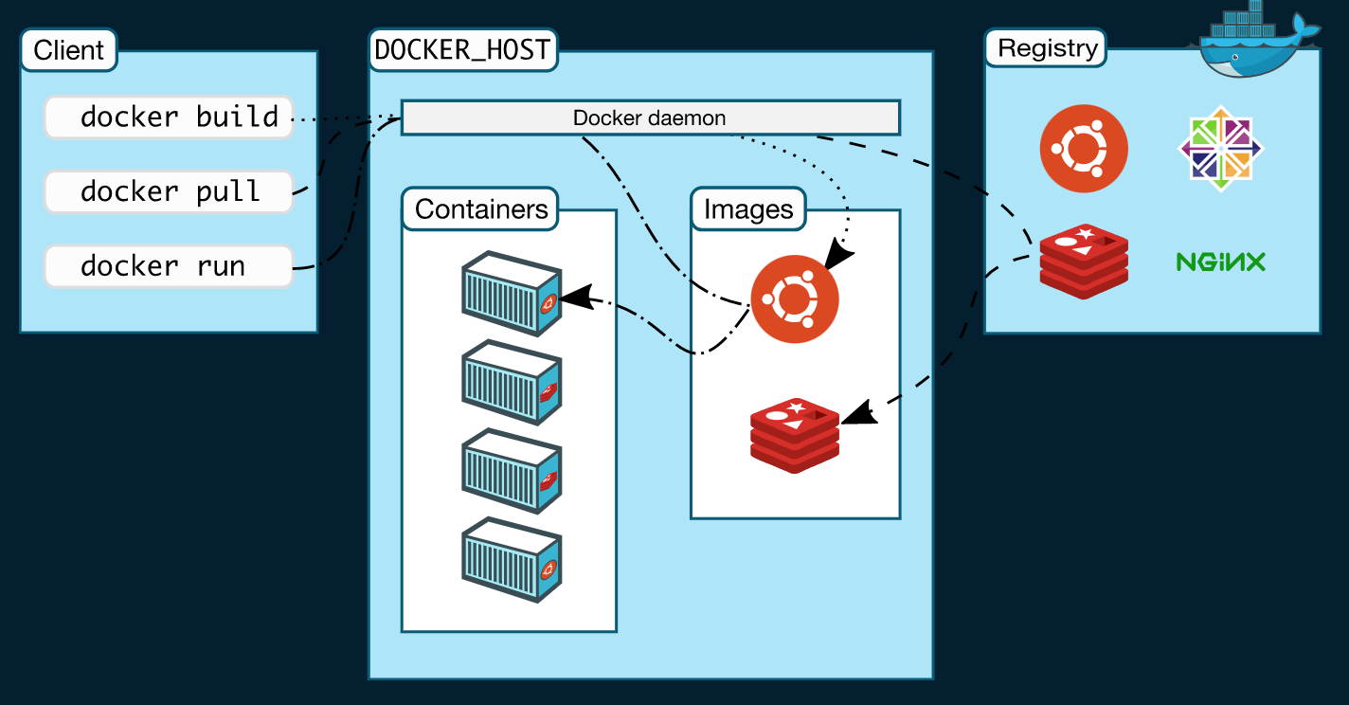
Docker Architecture
Docker uses a client-server architecture.
The Docker client talks to the Docker daemon, which does the building, running, and distributing Docker containers.
The Docker client and daemon can run on the same system, or can connect a Docker client to a remote Docker daemon.
The Docker client and daemon communicate using a REST API.
Another Docker client is Docker Compose, that lets you work with applications consisting of a set of containers.
A daemon can also communicate with other daemons to manage Docker services.

Slide 11
Problem with Containers
Containers are a good way to bundle and run applications
In a production environment, you need to manage the containers that run the applications and ensure that there is no downtime
For example, if a container goes down, another container needs to start. Wouldn't it be easier if this behavior was handled by a system?
Solution …Kubernetes
Kubernetes provides a framework to run distributed systems resiliently. It takes care of scaling and failover for application, provides deployment patterns, and more

Slide 12
Kubernetes
Services
Service discovery and load balancing
Storage orchestration
Automated rollouts and rollbacks
Automatic bin packing
Self-healing

Slide 13
Docker runs on a single node, whereas Kubernetes is designed to run across a cluster

Slide 14
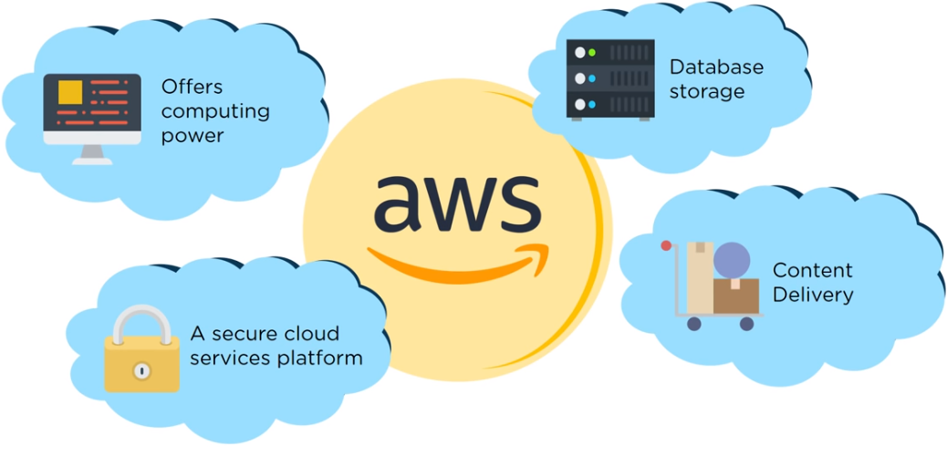
AWS
Amazon Web Services provides on-demand cloud computing platforms to individuals, companies and governments, on a metered pay-as-you-go basis.

Slide 15
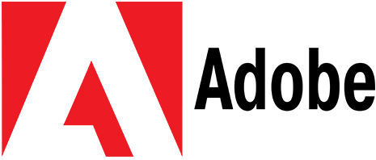












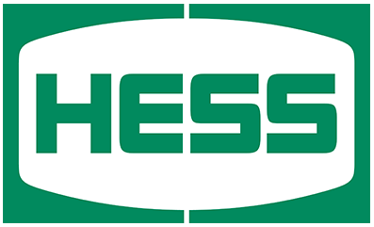


























Companies using AWS

Slide 16
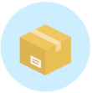
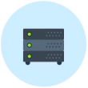

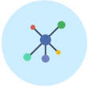
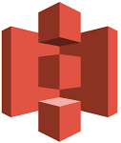
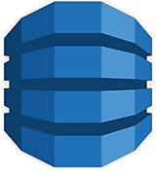
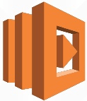
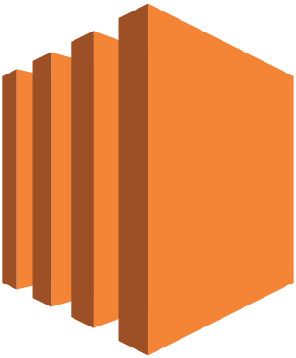

AWS Services
Storage
Storage
Compute
Networking and Content delivery
Amazon S3
dynamoDB
Amazon Lambda
Amazon EC2
Amazon API Gateway
An object storage that can store and retrieve data from anywhere.
A fully managed NoSQL database service.
A compute service that lets you run code without provisioning or managing servers
Provides secure and resizable compute capacity. Designed to make web-scale cloud computing easier.
Used to create, publish, maintain, monitor, and secure APIs

Slide 17
S3
Amazon Simple Storage Service (Amazon S3) is storage service for the Internet based applications
You can use Amazon S3 to store and retrieve any amount of data at any time, from anywhere on the web

Slide 18
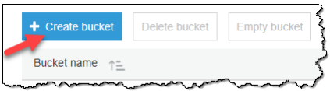
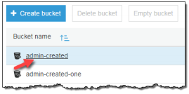
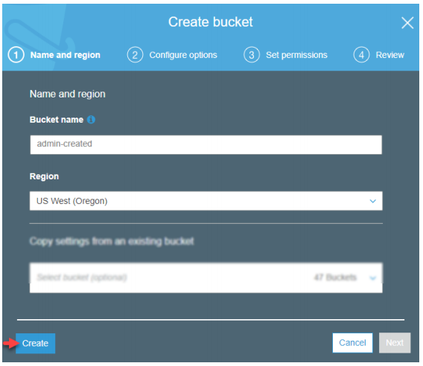
How to use the AWS Management Console to perform tasks in S3
Create a Bucket
Add an object to a Bucket
View an object
Delete an object and Bucket

Slide 19
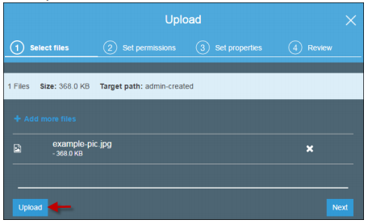
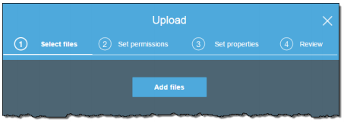
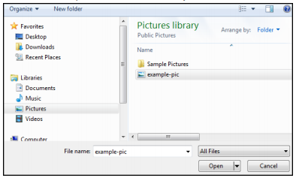
How to use the AWS Management Console to perform tasks in S3
Create a Bucket
Add an object to a Bucket
View an object
Delete an object and Bucket

Slide 20
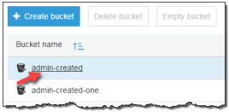
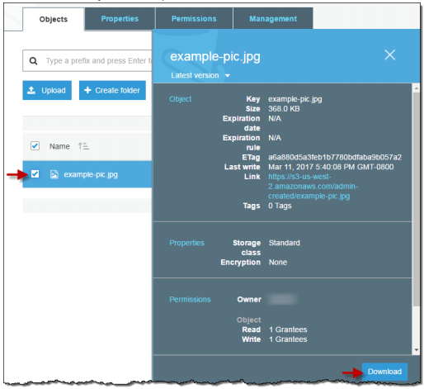
How to use the AWS Management Console to perform tasks in S3
Create a Bucket
Add an object to a Bucket
View an object
Delete an object and Bucket

Slide 21

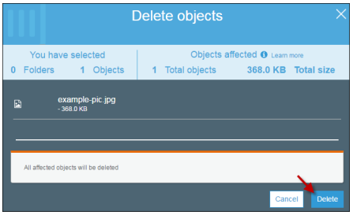
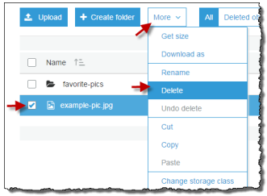
How to use the AWS Management Console to perform tasks in S3
Create a Bucket
Add an object to a Bucket
View an object
Delete an object and Bucket

Slide 22
AWS Lambda
A compute service that lets you run code without provisioning or managing servers
You can use AWS Lambda to run your code in response to events, such as-
changes to data in an Amazon S3 bucket
changes to data in an Amazon DynamoDB table
run your code in response to HTTP requests using Amazon API Gateway
invoke your code using API calls made using AWS SDKs
Lambda can be used to easily build data processing triggers for AWS services like Amazon S3 and Amazon DynamoDB

Slide 23
Lambda Functions
You upload your application code in the form of one or more Lambda functions to AWS Lambda
AWS Lambda executes the code on your behalf
Languages available to write your Lambda function code
Node.js
Java
C#
Python
Ruby
Go
PowerShell

Slide 24
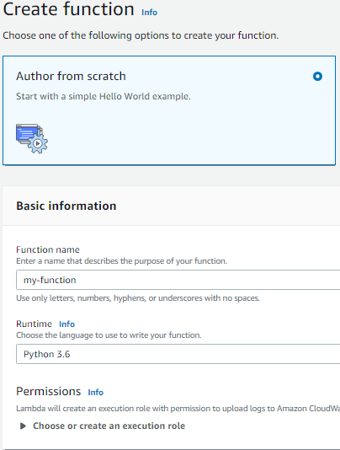
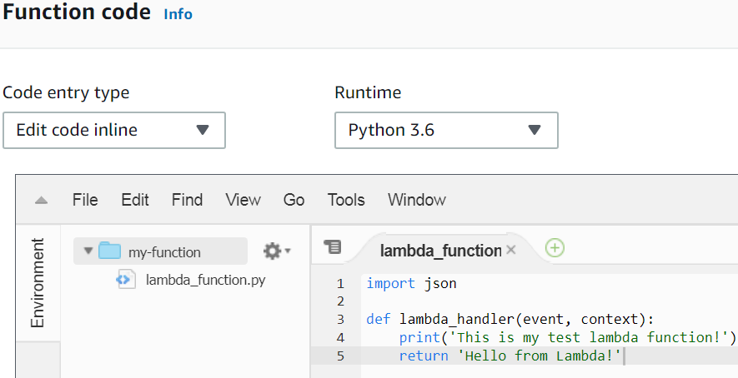
How to use the AWS Console to work with a Lambda Function
Create a function
Configure
triggers
Invoke a function
view logs

Slide 25
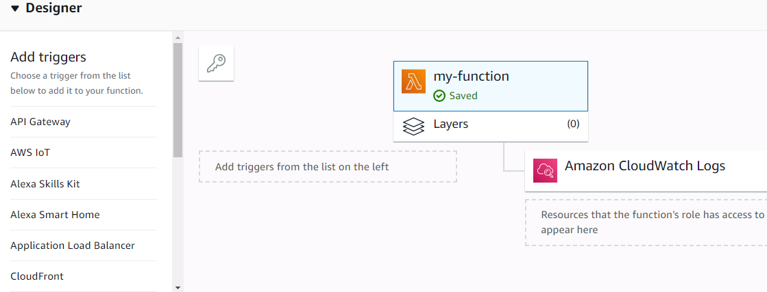
How to use the AWS Console to work with a Lambda Function
Create a function
Configure
triggers
Invoke a function
view logs

Slide 26
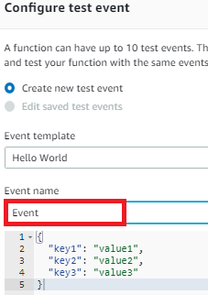
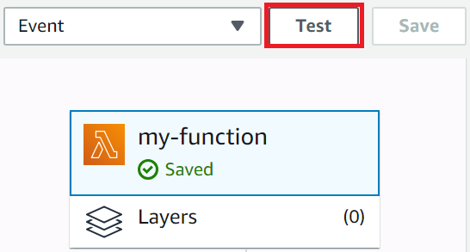
How to use the AWS Console to work with a Lambda Function
Create a function
Configure
triggers
Invoke a function
view logs

Slide 27
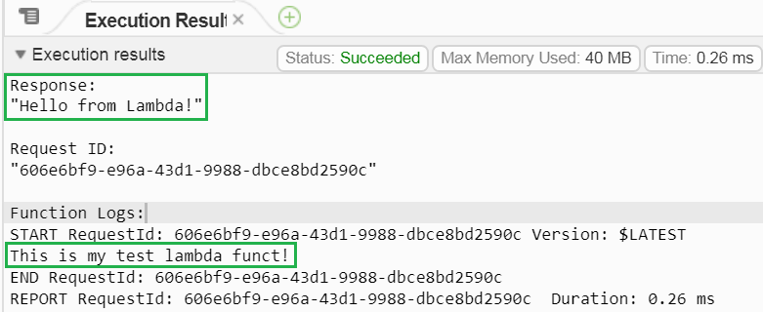
How to use the AWS Console to work with a Lambda Function
Create a function
Configure
triggers
Invoke a function
view logs

Slide 28
API Gateway
A service for creating, publishing, maintaining, monitoring, and securing APIs at any scale.
You can create APIs that access AWS or other web services as well as data stored in the AWS Cloud.
API Gateway creates REST APIs that:
Are HTTP-based
Adhere to the REST protocol, which enables stateless client-server communication.
Implement standard HTTP methods such as GET, POST, PUT, PATCH and DELETE.
With Amazon API Gateway, you can build an API to provide your users with an integrated and consistent developer experience to build AWS cloud-based applications.

Slide 29
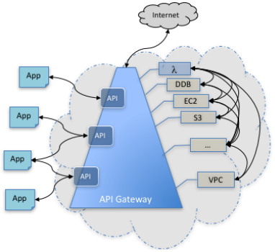
Architecture of API Gateway
APIs are hosted in API Gateway.
An app (or client application) gains programmatic access to AWS services, or a website on the internet, through one or more APIs
The app is at the API's frontend.
The integrated AWS services and websites are located at the API's backend.

Slide 30
DynamoDB
A fully managed NoSQL database service.
Provides fast and predictable performance with seamless scalability.
DynamoDB lets you oﬄoad the administrative burdens of operating and scaling a distributed database.
you can create database tables that can store and retrieve any amount of data, and serve any level of request traﬃc.
You can scale up or scale down your tables' throughput capacity without downtime or performance degradation.
Amazon DynamoDB provides on-demand backup capability.

Slide 31
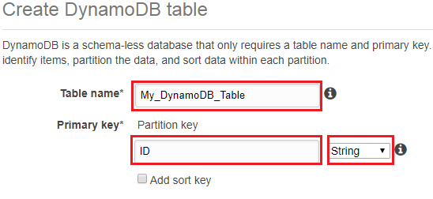
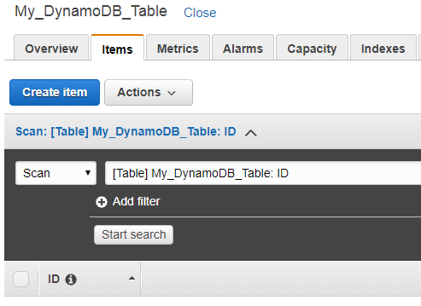
Creating a DynamoDB Table

Slide 32
EC2
Amazon Elastic Compute Cloud (Amazon EC2) is a web service that provides secure, resizable compute capacity in the cloud.
Eliminates your need to invest in hardware up front, so you can develop and deploy applications faster.
You can use Amazon EC2 to launch as many or as few virtual servers as you need, configure security and networking, and manage storage.
Enables you to scale up or down to handle changes in requirements or spikes in popularity, reducing your need to forecast traffic.

Slide 33
Features of Amazon EC2
Virtual computing environments, known as instances. Various configurations of CPU, memory, storage, and networking capacity for your instances, known as instance types.
Preconfigured templates for your instances, known as Amazon Machine Images (AMIs), that package the bits you need for your server (including the operating system and additional software)
Secure login information for your instances using key pairs (AWS stores the public key, and you store the private key in a secure place).
Storage volumes for temporary data that's deleted when you stop or terminate your instance, known as instance store volumes
Persistent storage volumes for your data using Amazon Elastic Block Store (Amazon EBS), known as Amazon EBS volumes
Multiple physical locations for your resources, such as instances and Amazon EBS volumes, known as Regions and Availability Zones

Slide 34
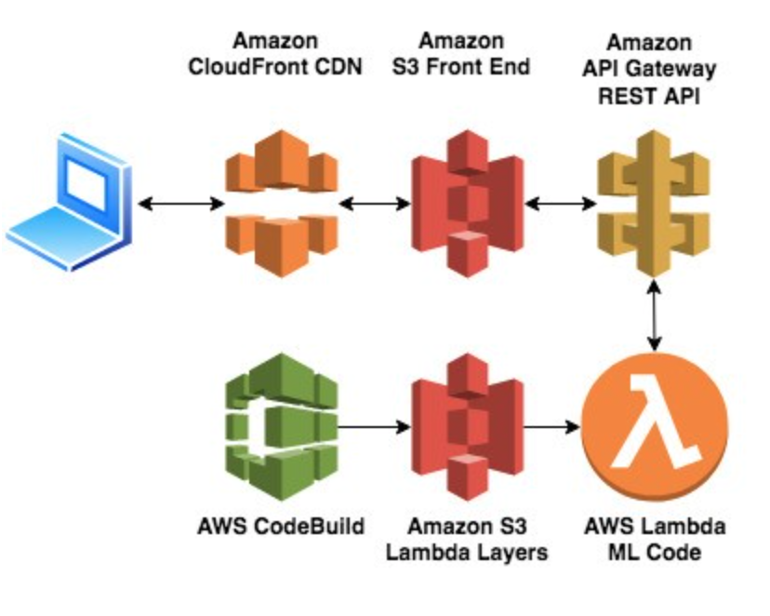
Demonstration
https://aws.amazon.com/blogs/machine-learning/deploying-machine-learning-models-as-serverless-apis/
After you create the CloudFormation stack, you can find the link to the site for detecting custom objects on the Outputs tab on the AWS CloudFormation console.
In this, an object detection model from GluonCV performs inference on images.

